Slide 1
E-Safety for Parents and Carers
*Look at how children use the internet
*Raise awareness of e-Safety issues and gaming issues
*Offer guidance on how to help keep children safe online
Notes:
Introduce the session saying that parents and carers have a key role to play in creating a safe ICT learning environment and culture, through promoting Internet safety/ ICT safety at home and thus reinforcing the messages taught in school.
ICT is a very exciting subject and the technology brings enormous benefits to us all both educationally and socially. ICT plays a key role ICT in supporting learning and teaching

Slide 2
Benefits of technology for children:
  fun
  educational
  can help raise standards
  helps build creativity
  enables communication with friends and family
Notes:
Although this is a survey of children how many of us are part of these statistics?
There are many websites that are biased, misleading or just untrue. How can we help our children and young people to distinguish between these?

Slide 3
Main reason why children are not protected…
Being behind a screen doesn’t feel like real life.
Children are sometimes innocent to the dangers that are present.
Children are always keen to interact with people that are older than themselves but are not yet ready/resilient enough to manage this and are not aware that they will maybe exposed to things that are not age appropriate.

Slide 4
“70% of parents feel that their children know more about the internet than they do”
(Ofcom Media Literacy 2011)

Slide 5
Some of the technologies……
Mobile phones
What next
???
Instant
messaging
BLOGS
Social
networking
Music
Download
sites
E-mail
Gaming sites
Podcasting
Wikies
Chat Rooms
Video
broadcasting
P2P
file-sharing
Text
Notes:
This slide identifies some of the technologies currently being used by our children and young people.
What Next ??? New technologies are continuing to evolve and will probably link location to the user which will raise many eSafety issues. We need to ‘watch this space’!
The following slides look at some of these technologies in greater detail to help clarify understanding.
The following do not have slides but here are the definitions if needed:
eMail – many adults used email as part of their daily life.
Wiki ( Hawaiian word meaning quick) – First Wiki was in 1995. It is a simple piece of software that allows users to freely add, remove and edit Web page content using any Web browser. It has an “open editing" concept which means that anyone can edit the content with the changes being tracked. Wikipedia is the most well known – a web based encyclopaedia. It is a really good place to go to find out definitions

Slide 6

Anytime ⬄ Anywhere
Camera phones
Text messages
Internet access
e-mail
MP3 player
Chat and IM
Downloads
Mobile TV
Notes:
This is an area that is really developing at a rapid rate – we have already
mentioned iPhones. If you have a mobile phone just think back to your first
phone and compare it with your current phone It is important to recognise
that the mobile phone is now capable of so much more than voice calls and
text messages.
So what can mobiles do now –
Camera Phones including video and MMS (Multi-Media Messaging) – the
phones used as a camera are growing in importance. People do not
always have a camera with them, but they always have their phone. News
items often include video taken from a onlooker using their mobile phone.
Internet Access – which means that as well as finding information and
using email children can access chat rooms, social networks etc
MP3 player – reports are starting that sales of i-pods are falling due to the
realisation that Mobiles can serve that function
Mobile TV – a much talked about development, trials have taken place.
Downloads – can download music, games, pictures, video from the
Internet.
Games – not just Tetris or Snake. Can be multi-player games, and you can
be chatting with your team mate or opponent very often while you play.
Moblogs – uploading/ posting content onto the Internet from a mobile.
Posts of images, texts etc.
Further information can be found at Childnet
http://www.childnet-int.org/

Slide 7
Risks
Children make online ‘friends’ and chat to people who are unknown who may pose a risk to them
Children may upload or view inappropriate material
Sharing files can lead to spyware, identify theft and greater vulnerability to viruses.
Risk of cyber bullying
Notes:
A blog is a website in which items are posted on a regular basis and displayed in reverse chronological order. Like other media, blogs often focus on a particular subject, such as food, politics, or local news. Does your local town have a blog? Some blogs function as online diaries. A typical blog combines text, images, and links to other blogs, web pages, and other media related to its topic. Since its appearance in 1995, blogging has emerged as a popular means of communication, affecting public opinion and mass media around the world.
A video blog, sometimes shortened to vlog, is a blog that comprises video.
A blog can be a great way for a school to record a field trip as it actually happens. This enables fellow pupils, teachers and parents/ carers to be kept up to-date through pupils adding comment and uploading video of their trip.

Slide 8
School approach to E-safety
Safe: keeping personal information safe
Meeting: online friends are strangers
Accepting: be aware of viruses
Reliable: information may be untrue
Tell: inform an adult

Slide 9
Keeping Personal Information Safe
Jigsaw video

Slide 10
School Home
?
Supervised
Monitored
Filtered
Curriculum
Rise of smartphone and ipad
Notes:
The Hertfordshire Grid for Learning provides a filtered access.
School monitors pupils and have acceptable use policy/ pupils rules.
The curriculum supports eSafety.
What happens in the home?? Supervision at home important but can be difficult because our young people protect their privacy.
Ideally we all should work together to provide the same message.
.
Schools often provide internet usage in an ‘enclosed’ environment – heavily restricted, but once children and young people are outside of school there is often limited supervision (with even less restriction when children use mobile phones)

Slide 11
Access to technology
Where?
Internet agreements
with your child
Limit time using technology
Think about where they use technology - webcams
Take technology at night
When?
¼ of children admitted to missing sleep because of technology
2/3s of children said using technology interrupted time doing schoolwork and spending time with friends and family

Slide 12
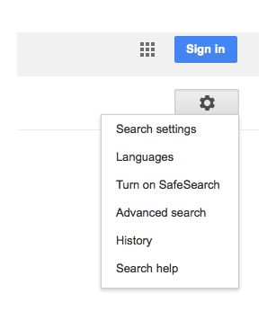
What to do?
Check history of websites children have viewed
Turn on Safe Search in Google

Slide 13
Encourage use of child friendly search engines e.g. Yahooligans
Use safe search apps on iphones and ipads e.g. K9 browser
Think about when your child needs a mobile phone. Contact the provider to put restrictions on usage.

Slide 14
Make sure you use a firewall and have anti-virus software
Set up a family email for websites children access
Encourage children to not use a nickname on sites and not share personal information

Slide 15
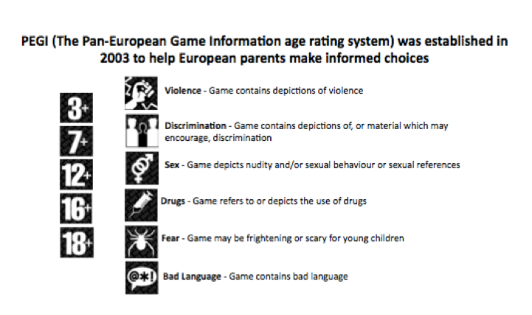
Gaming
Massively multiplayer online role playing games
Talk to children about playing with strangers and giving personal information

Slide 16
Gaming
https://www.youtube.com/watch?v=-AX5sIDb8gE

Slide 17



Social
networking
18% of 9 to 10 year olds and 25% of 11 to 12 year olds have a Facebook profile
14% accept all friends
Only half keep their profiles private
¼ give a false age
3% meet up with someone online that they have never met
Notes:
A social network is an online community that can chat, have a notice board and generally communicate with “friends” . These networks are part of many peoples, especially the young, daily lives There are hundreds of social networking sites on the web. Some are aimed at professionals and focus on work related topics. Many other are aimed at young people and have vast populations In the UK Friends Reunited was one of the early social networking sites. It was based on shared history, such as school friends and has been used as a model for most social networks which have now evolved to incorporate a very wide and diverse group of “friends” The etiquette on these sites is to post information about yourself which is totally against ALL eSafety advice.
Bebo, MySpace, facebook are not accessible in school together with any other known sites. There are many other similar sites with new ones springing up every day and it is often possible to get round most filtering to access these networks.
New research from USA indicates that 61 per cent of 13 to 17-year-olds have a personal profile on websites such as MySpace. Half of those have also posted pictures of themselves online.

Slide 18
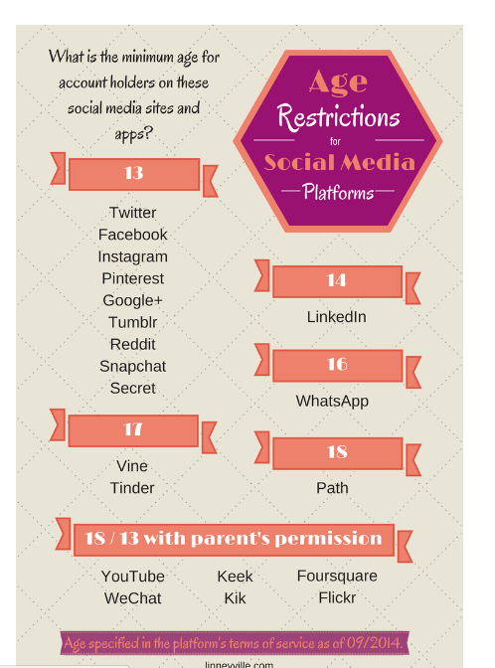

Slide 19
Ban or Educate?
Facebook and most other social media sites are for over 13 year olds.
Build a profile with your child. Discuss what personal information to share.
Set a strong password.
Talk openly with your child about these things.
Discuss which photos are appropriate to post and how they can be misused.
Explain that friends should be people they know.
Set strong privacy settings to friends only.

Slide 20
For more information…..
www.thinkuknow.com
http://www.parentscentre.gov.uk/
http://www.getnetwise.org/
http://www.childnet-int.org/
http://www.bbc.co.uk/webwise/
http://www.iwf.org.uk/
http://www.internetmatters.org/age-guides/videos.html
http://facebook.com/safety

Slide 21
Useful safe websites for links across the curriculum, including games and general resources:
  http://www.bbc.co.uk/schools/parents/
  http://www.topmarks.co.uk/
  http://www.woodlands-junior.kent.sch.uk/Games/
  http://www.bgfl.org/bgfl/15.cfm?s=15&p=251,index
  http://www.bbc.co.uk/schools/
  http://durham.schooljotter.com/coxhoe/Curriculum+Links

